Slide 1
PROBIOTICS
PROBIOTICS
“Good bacteria for better health”
Probiotics are live microorganisms which, when administered in adequate amounts, confer a health benefit on the host.
Probiotics are
Live beneficial microorganisms
Mainly bacteria and some yeasts
Naturally present in the gut
Help maintain healthy intestinal flora

Slide 2
PROBIOTICS
Common Probiotic Microorganisms
Lactobacillus species
Bifidobacterium species
Saccharomyces boulardii (yeast)
Streptococcus thermophilus
Sources of Probiotics
Curd (yogurt)
Buttermilk
Kefir (fermented milk drink)
Fermented foods (idli, dosa batter)
Probiotic supplements

Slide 3
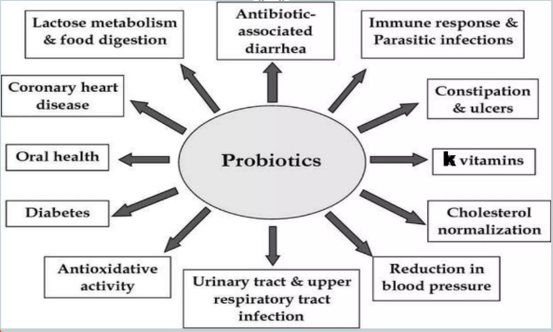
BENEFITS OF PROBIOTICS

Slide 4
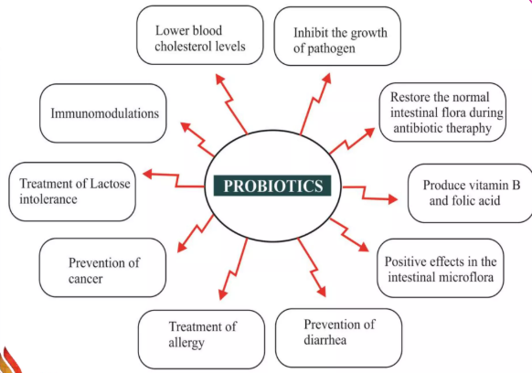
BENEFITS OF PROBIOTICS

Slide 5
SIDE EFFECTS OF PROBIOTICS
Mild gas and bloating
Diarrhea
Headaches
Allergic Reactions
Abdominal Pain
Nausea

Slide 6
PREBIOTICS
Prebiotics are substance that induce the growth of microorganisms that contribute to the well-being of their host.
A person’s gut microbiome consists of trillions of living organisms called gut microbiota. The organisms are necessary for various important bodily functions, immune system support and nutrient metabolism.
Prebiotics help to promote and sustain a healthy gut microbiome. They are non-digestible nutrients that the bacteria in the gut, including probiotics, can break down and use.
The microbiota ferment these nutrients, which release short-chain fatty acids (SCFAs) as a by-product. SCFAs are involved in various bodily functions, including inflammation and immune system regulation.

Slide 7
BENEFITS OF PREBIOTICS
The benefits of prebiotics are wide-ranging.
Help regulate bowel movements.
Produce neurotransmitters that go back and forth between your gut and your brain to trigger mood changes and other processes.
Stimulate your body to make hormones that aid in appetite, appetite suppression and more.
Help your bones mineralize and absorb calcium and phosphorus, which can improve bone density.
Improve how well your immune system functions.
Enhance your body’s anti-inflammatory response.
Increase production of good bacteria and decrease bad bacteria that causes disease.

Slide 8
SOURCES OF PREBIOTICS
Bananas
Bananas, especially when slightly unripe, are an excellent source of resistant starch. Resistant starch is a prebiotic fiber. This starch helps in the growth of beneficial gut bacteria and aids in digestion.
Garlic
Garlic contains inulin, a fiber that acts as a prebiotic. Inulin is known for promoting gut health by enhancing the growth of friendly bacteria.
Onions
Onions are rich in inulin and fructooligosaccharides (FOS), These are known to promote the growth of healthy gut bacteria.
Chickpeas (Chana)
Chickpeas are rich in resistant starch and fiber, making them a great prebiotic food. They support the growth of good bacteria and contribute to better digestion.
Sweet Potatoes
Sweet potatoes are a rich source of resistant starch and fiber, which nourish gut bacteria.
Curd (Yogurt)
Curd is not only a source of probiotics (live bacteria) but also contains prebiotic fiber, which nourishes these beneficial bacteria.

Slide 9
SOURCES OF PREBIOTICS
Apples
Apples contain pectin, a type of soluble fiber that acts as a prebiotic, supporting the growth of beneficial gut bacteria.
Jowar (Sorghum)
Jowar is a whole grain rich in fiber and resistant starch, which acts as a prebiotic and helps promote gut health.
Ragi (Finger Millet)
Ragi is high in fiber and polyphenols, which contribute to a healthy gut microbiome.
Amla (Indian Gooseberry)
Amla is packed with vitamin C and fiber, which help maintain gut health. It is also known for promoting digestion and detoxifying the body.
Bitter Gourd (Karela)
Bitter gourd is a good source of fiber and antioxidants that contribute to gut health by promoting the growth of beneficial bacteria.
Coconut
Both coconut meat and coconut oil contain fibers like lauric acid, which helps promote the growth of gut bacteria.
Flaxseeds
Flaxseeds are rich in fiber and omega-3 fatty acids, which help improve gut health by nourishing beneficial gut bacteria.

Slide 10
SYNBIOTICS
The term “synbiotics” refers to any supplement that contains a blend of both prebiotics and probiotics.
Synbiotics can help support gut health by increasing the amount of beneficial bacteria in the digestive tract while also providing these bacterial cells with the fuel they need to function and thrive.
Benefits of Synbiotics
Support Digestive Health
Enhance Immune Function
Improve Mental Health
Boost Weight Loss
Promote Heart Health
Decrease Inflammation

Slide 11
SYNBIOTICS
Risks and Side Effects
Prebiotics are fermented in the gut and can cause adverse digestive symptoms when consumed in high amounts.
Probiotics may also contribute to negative side effects, such as diarrhea or abdominal pain, especially when supplementation is first initiated. For this reason, it’s best to start with a low amount of synbiotics and increase dosage gradually to assess tolerance.
You should also be sure to increase your water intake when consuming more prebiotic foods. This is because prebiotic foods are typically high in fiber, which absorbs water in the colon.
Not only can this slow down digestion, but it can also cause side effects like dehydration and constipation.
Drinking more water can help prevent these adverse side effects and keep things running smoothly within the digestive tract.

Slide 12
NATURAL SYNBIOTIC FOOD COMBINATIONS
Yogurt + Banana
  Yogurt → Probiotic
  Banana → Prebiotic (inulin, resistant starch)
Curd Rice + Onion
  Curd → Probiotic
  Onion → Prebiotic
Buttermilk + Garlic
Fermented Idli/Dosa + Sambar (with onions & legumes)
  Fermented batter → Probiotics
  Legumes/onions → Prebiotics

Slide 13
NUTRIENT Vs NON-NUTRIENT
Aspect | Nutrient | Non-Nutrient
Definition | Chemical substances in food required for growth, energy, repair and regulation of body functions | Substances in food that are not essential nutrients but may influence health
Essentiality | Essential for survival and normal body function | Not essential for survival
Energy value | Some provide energy (carbohydrates, fats, proteins) | Usually do not provide energy
Role in body | Build tissues, provide energy, regulate metabolism | May aid digestion, protect against disease, add color/flavor
Examples | Carbohydrates, Proteins, Fats, Vitamins, Minerals, Water | Dietary fiber, Phytochemicals, Flavonoids, Tannins, Artificial colors, Preservatives

Slide 14
OVERNUTRITION
Overnutrition refers to an excessive intake of dietary energy, largely from macronutrients like carbohydrates, fats, and proteins, beyond what the body expends. When energy intake consistently exceeds expenditure, the body stores this surplus.
Eg.,
Carbohydrates are first stored as glycogen in the liver and muscles; once full, excess carbohydrates convert to fat.
Fats, an energy-efficient fuel source, are stored as triglycerides in fat cells.
Proteins, primarily used for tissue repair, can also convert to fat if consumed in excess.

Slide 15
FACTORS CONTRIBUTING TO OVERNUTRITION
A high intake of energy-dense foods, particularly ultra-processed options and sugary beverages, contributes significantly to caloric excess.
Sedentary lifestyles further exacerbate the problem by reducing energy expenditure. Increased reliance on modern conveniences and extended screen time means fewer opportunities for physical activity.
Environmental influences also shape food choices. Easy access to unhealthy foods, often promoted through extensive marketing, can encourage overconsumption.
Socioeconomic factors significantly influence dietary patterns. Individuals with lower economic status often face limitations in accessing nutritious food, relying instead on cheaper, energy-dense foods.
Genetic predispositions can influence an individual’s metabolism and appetite, making some more susceptible to weight gain. While genetics play a part, environmental and lifestyle factors generally exert a more substantial influence on overnutrition development.

Slide 16
HEALTH IMPLICATIONS OF OVERNUTRITION
Chronic overnutrition can lead to a range of serious health problems.
Metabolic disorders are commonly associated with excessive nutrient intake. These include Type 2 diabetes, where cells become resistant to insulin.
Overnutrition contributes to high blood pressure and unhealthy cholesterol levels, increasing the risk of heart disease and stroke.
Overnutrition and obesity are linked to an increased risk of certain cancers.
Musculoskeletal issues also arise from increased strain on joints.
Sleep apnea, where breathing repeatedly stops during sleep. Excess fat deposits in the neck can narrow the airway, and increased abdominal girth can compress the lungs, making breathing difficult.
Overnutrition can also affect mental health, contributing to body image concerns, negative self-esteem, and an increased risk of depression and anxiety.

Slide 17
CHRONIC DEGENERATIVE DISEASES
A degenerative disease is a condition characterized by the progressive and irreversible deterioration of cells, tissues, and organs. This degradation occurs over time and can result in loss of function, disability, or cell death.
Degenerative diseases can be classified according to the affected tissue or organ, such as :
Neurodegenerative Diseases: A group of complex diseases characterized by neuronal loss and the progressive degeneration of different areas of the nervous system.
Musculoskeletal Degenerative Diseases: Diseases that generally cause degeneration of the joints, cartilage, and bone structures, leading to pain, inflammation, stiffness, or loss of mobility.
Cardiovascular Degenerative Diseases: Conditions in which there is a progressive accumulation of atheromatous plaques in the arteries, leading to reduced blood flow and increasing the risk of events such as heart attacks and strokes.

Slide 18
MAIN DEGENERATIVE DISEASES
Alzheimer’s Disease (AD)
It is the most common form of neurodegenerative disease and the leading cause of dementia, representing 60-80% of cases. This condition is characterized by neuronal loss and cognitive dysfunction and is rapidly becoming one of the most costly, deadly, and burdensome diseases of the century.
Parkinson’s Disease (PD)
It is a chronic and progressive neurodegenerative disorder that primarily affects older adults, although it can also appear in younger patients. It is the second most common neurodegenerative disease, affecting about 4 million people worldwide.
Osteoporosis
Osteoporosis is characterized by low bone mass and microstructural deterioration of bone tissue, which increases bone fragility and raises the risk of fractures.
Multiple Sclerosis (MS)
In multiple sclerosis, the immune system attacks the myelin, the protective layer around nerves in the brain and spinal cord due to inflammation. This damage to the myelin interferes with communication between the brain and the rest of the body, causing delayed or blocked nerve signals, which can lead to a variety of neurological symptoms and impact quality of life and functional capacity.

